Slide 1

HOUSE HUNT
TEAM 1
NITANT PARESHBHAI BHAGAT
BHUMI ASHOKBHAI TADHANI
NAGA BAVANA KOLASANI
BHARGAV PATEL
HARSH DEEPAKKUMAR MODI
ABHISHEK SUNIL TAMBOLI
VRAJDEEP DILIPBHAI LUNAGARIYA
JENISHA BHAVESHBHAI GAJERA
MANISH THOTAKURA
SAI NADH BATTALAPALLI

Slide 2

AGENDA
BRM & SIPOC DIAGRAMS
CONTEXT DIAGRAM
ROAD MAP
RCT (main view only)
USER STORIES
UML ACTIVITY DIAGRAM
ER DIAGRAMS (Conceptual, Logical)
BURNDOWN CHARTS
JENKINS PROGRESS REPORT
APPLICATION DEMO [Recorded]

Slide 3
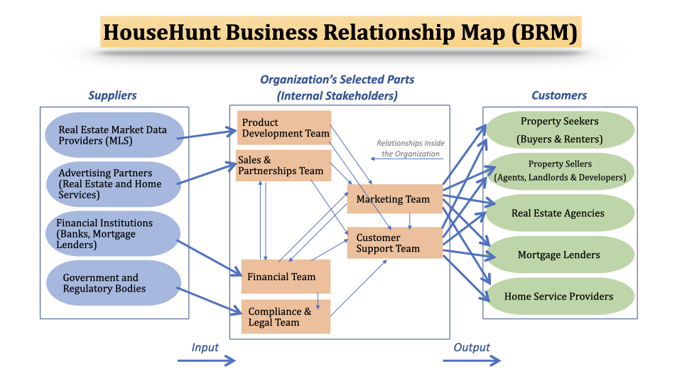
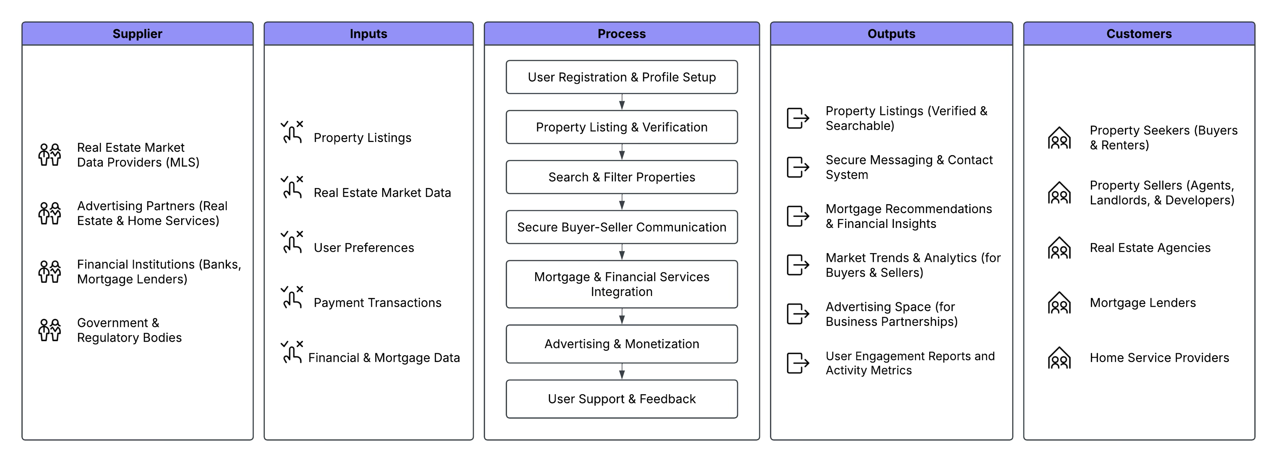
BRM & SIPOC DIAGRAMS - (NAGA BAVANA KOLASANI)
BRM DIAGRAM
SIPOC DIAGRAM

Slide 4
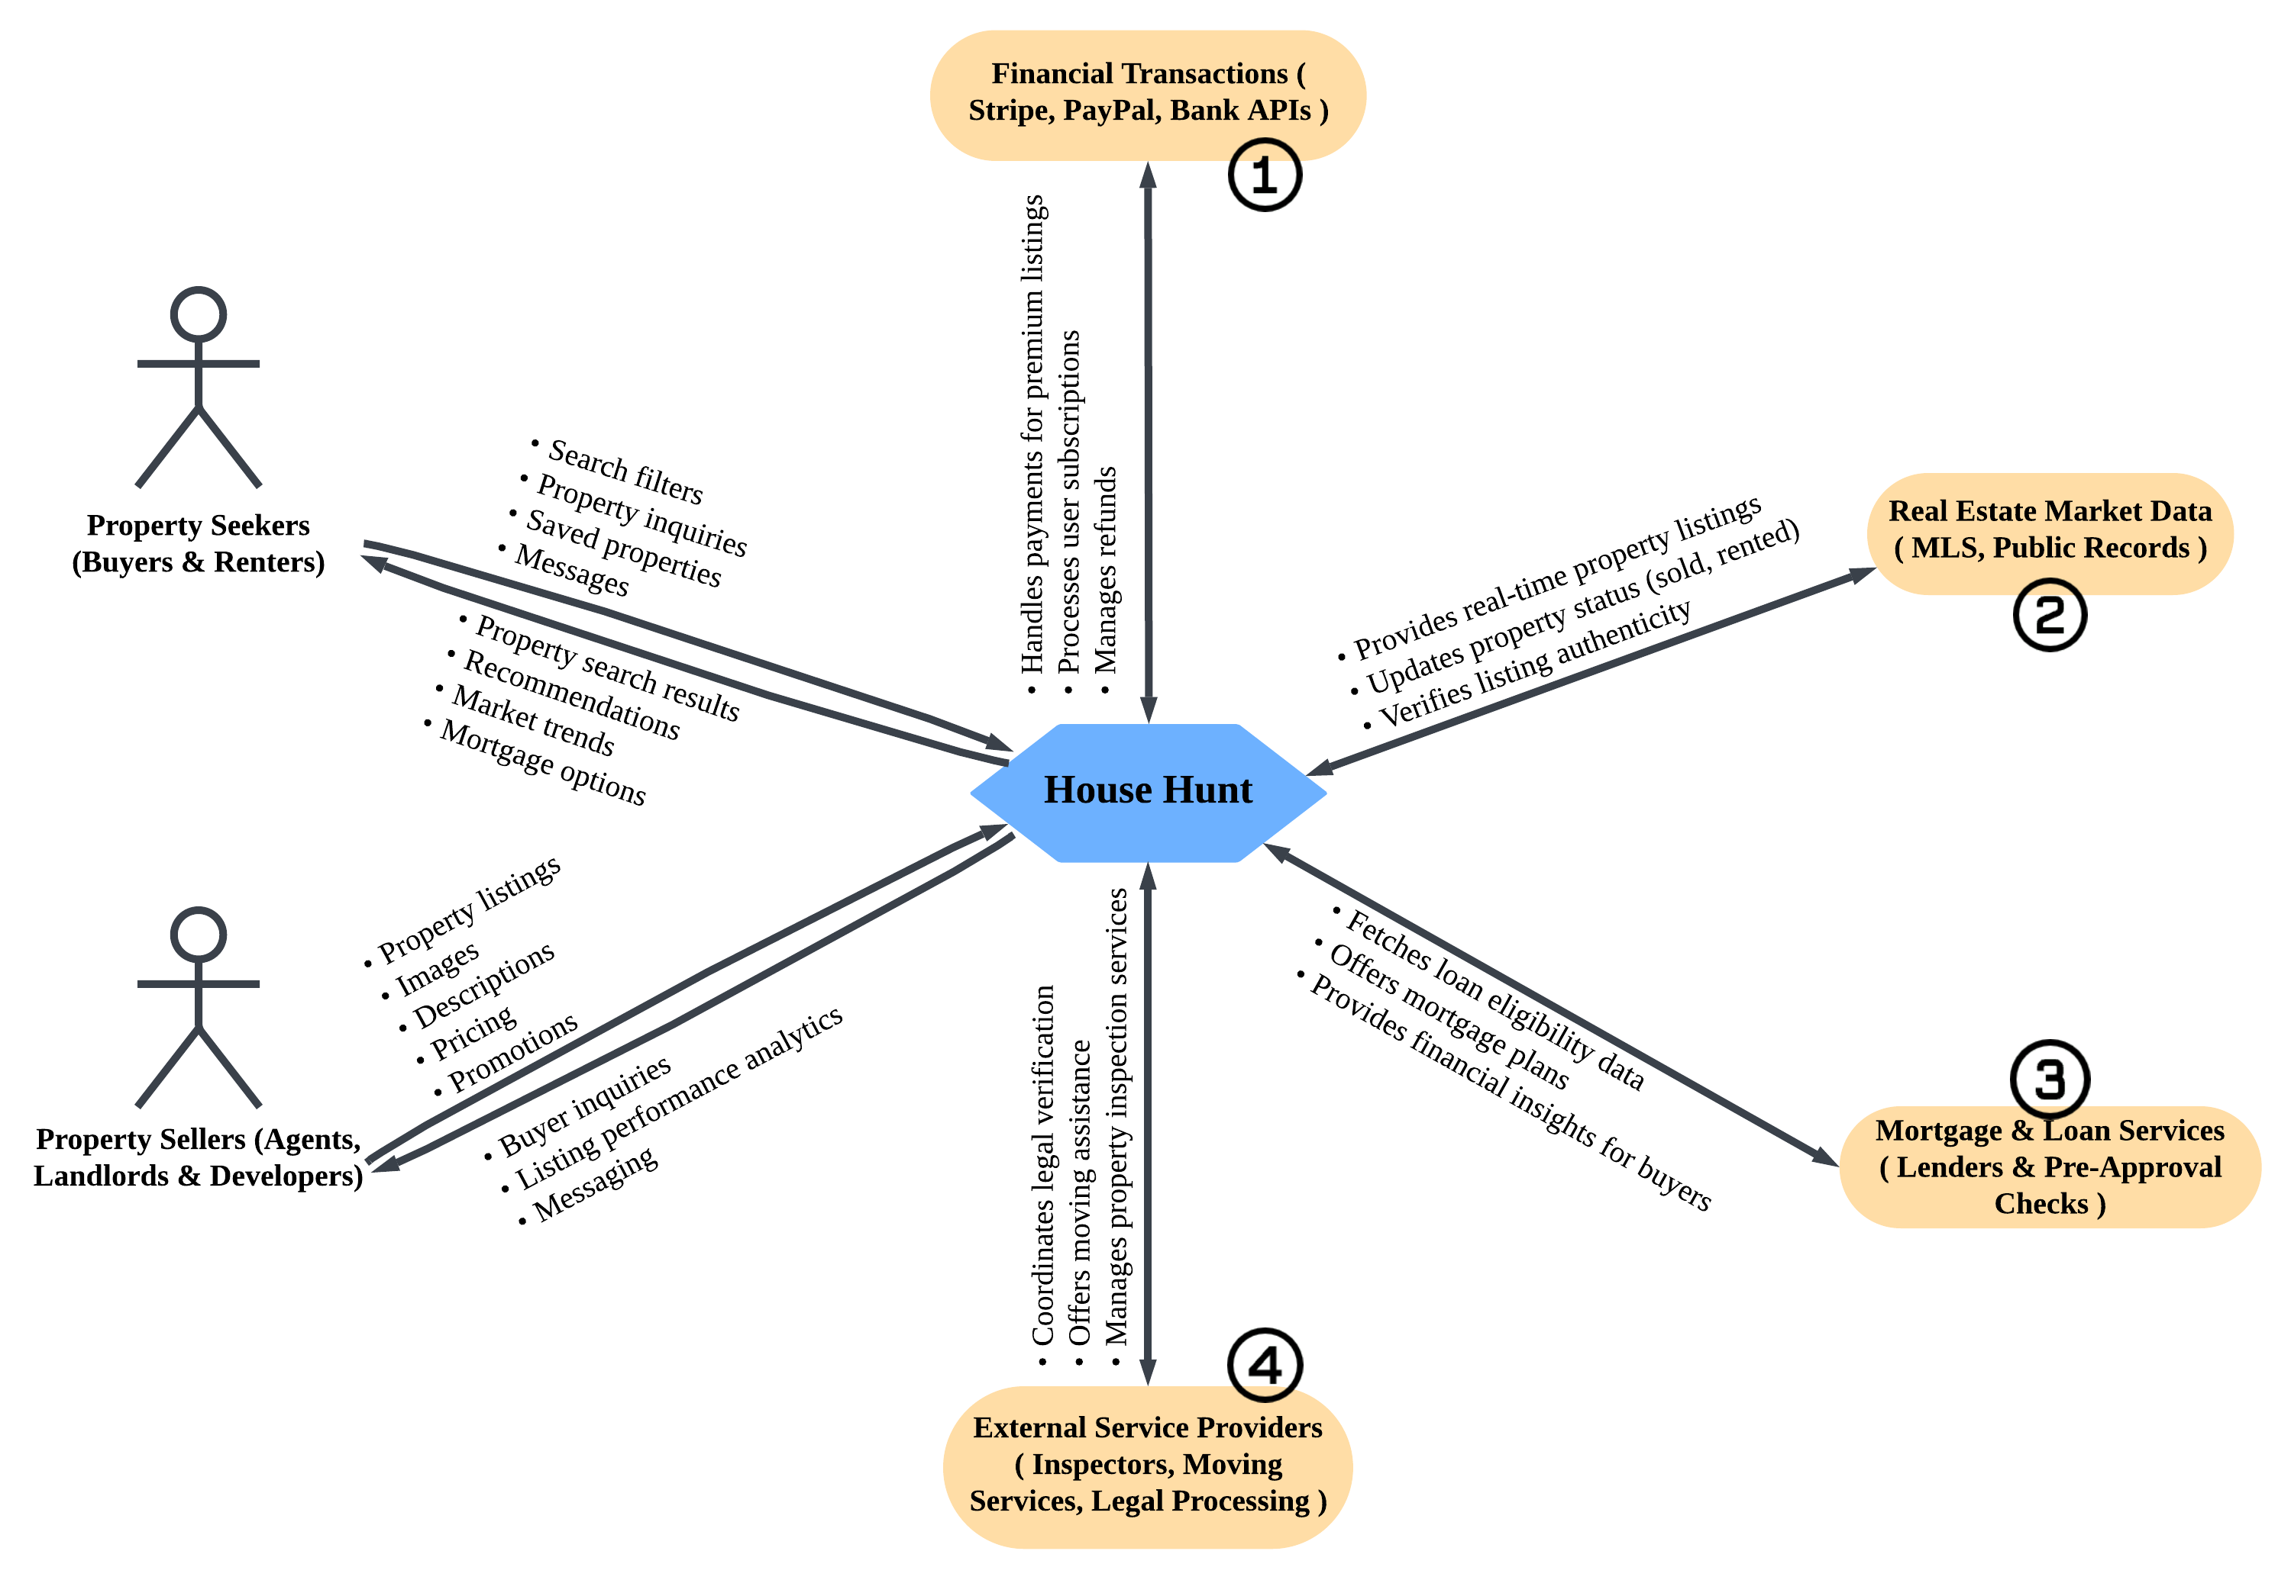
CONTEXT DIAGRAM - (HARSH DEEPAKKUMAR MODI)

Slide 5
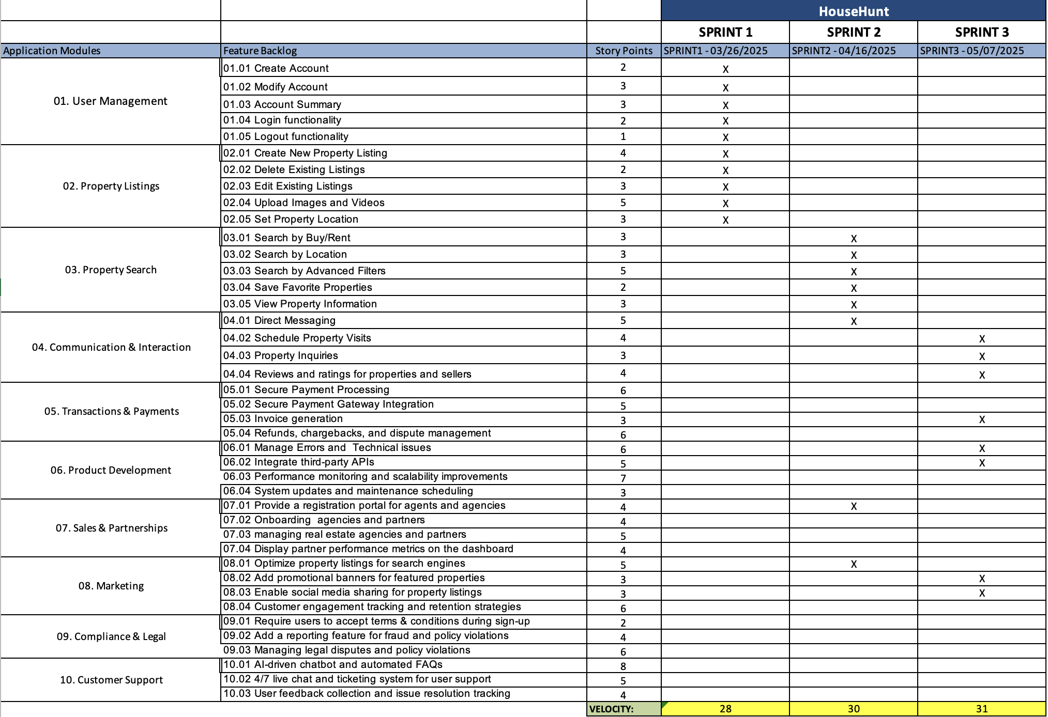
ROAD MAP - (VRAJDEEP DILIPBHAI LUNAGARIYA)

Slide 6
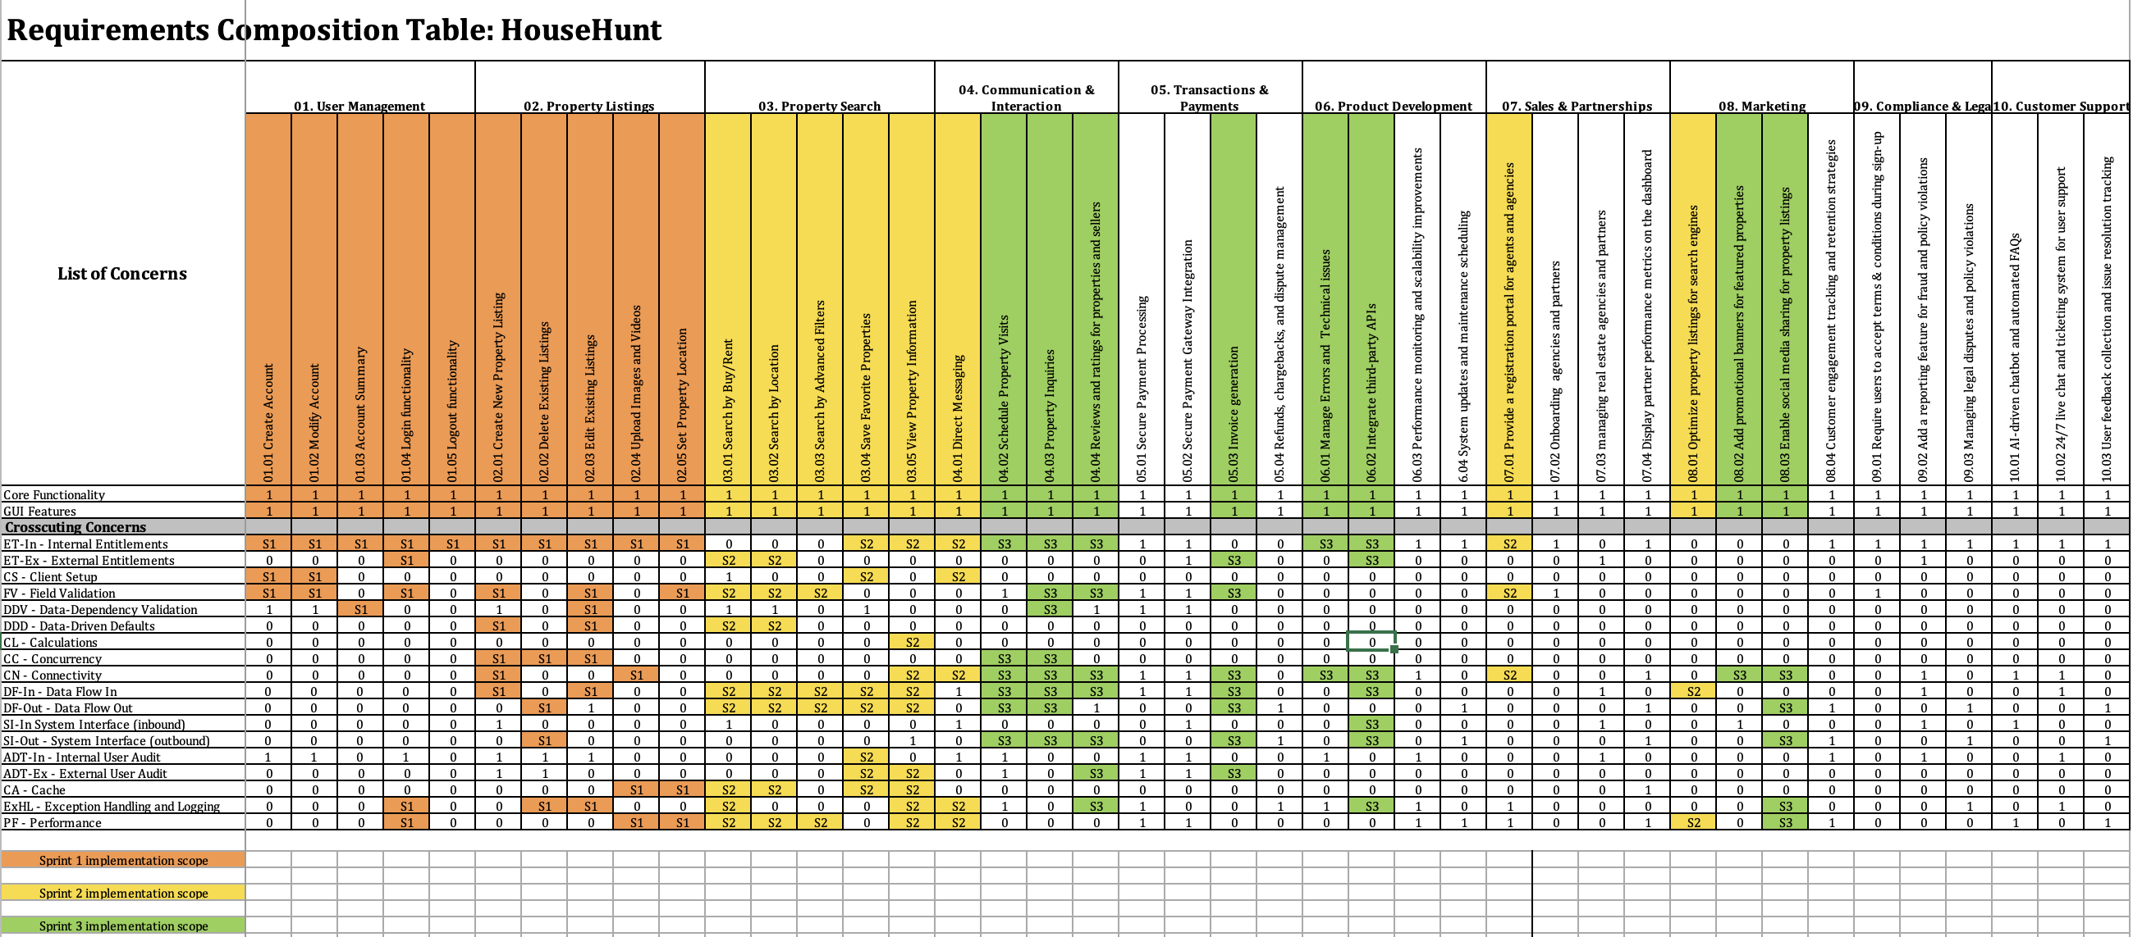
RCT - (BHUMI ASHOKBHAI TADHANI)

Slide 7
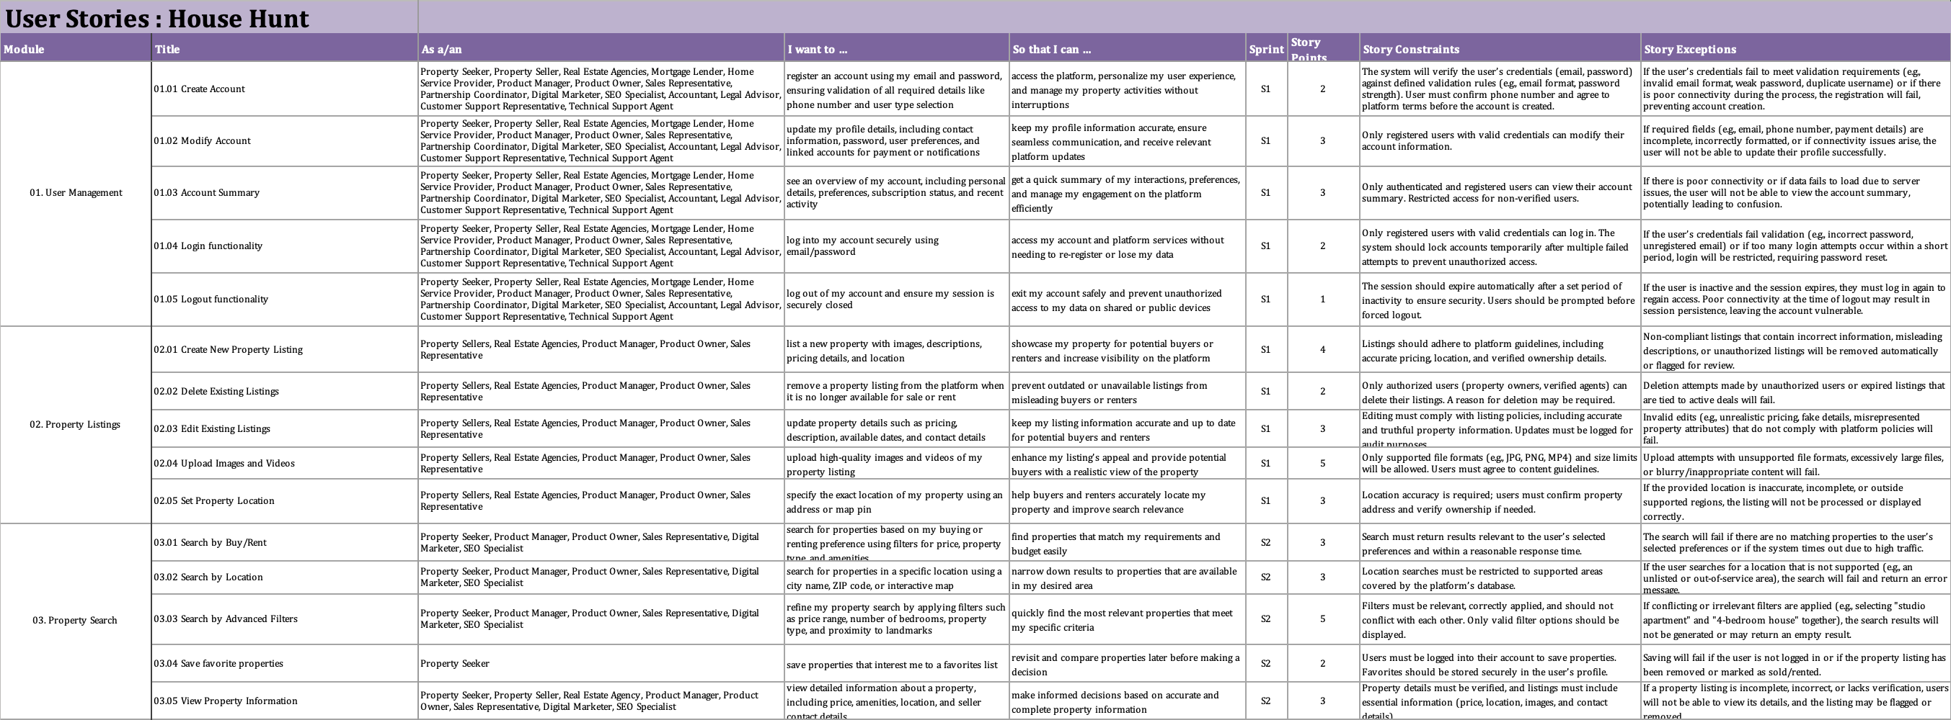
USER STORIES - (SAI NADH BATTALAPALLI)

Slide 8
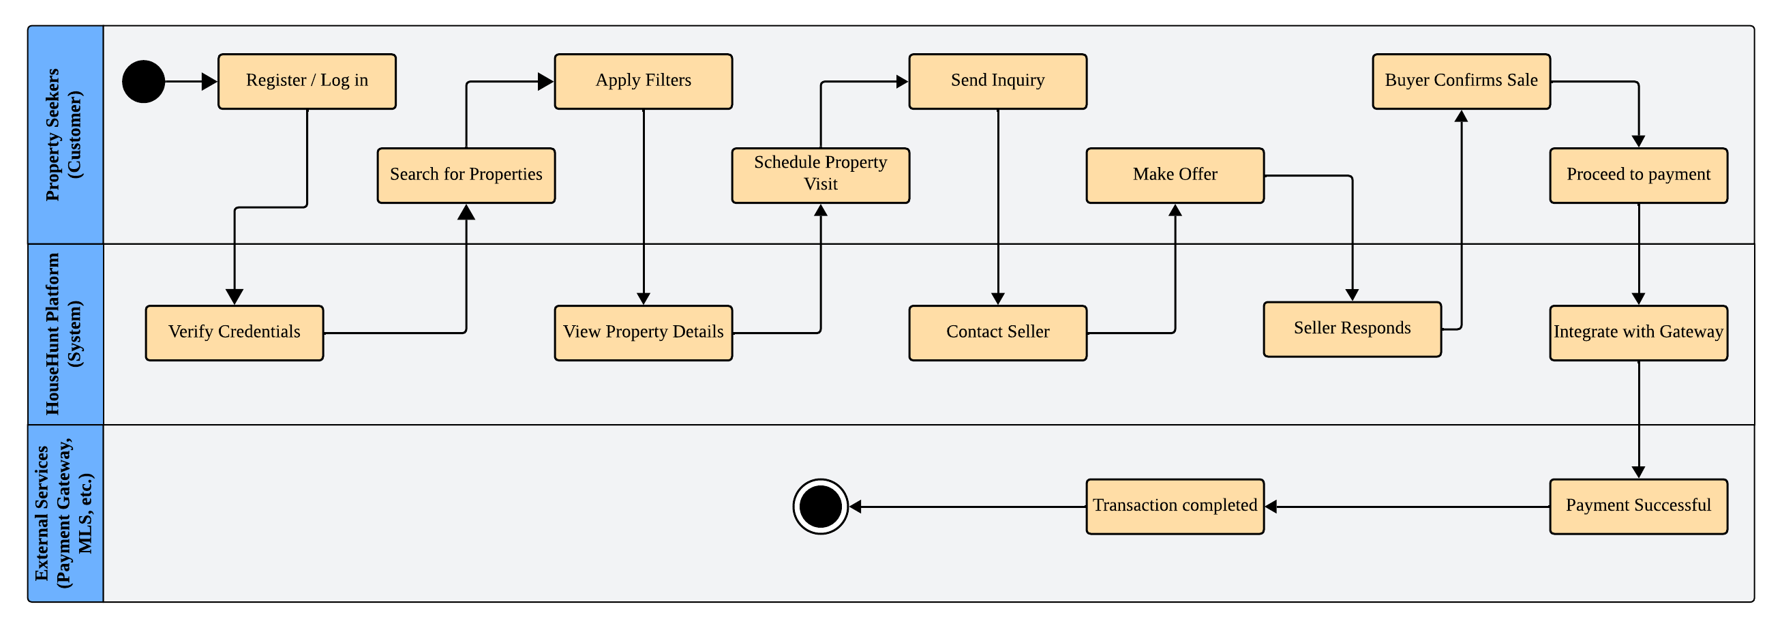
UML ACTIVITY DIAGRAM - (MANISH THOTAKURA)

Slide 9
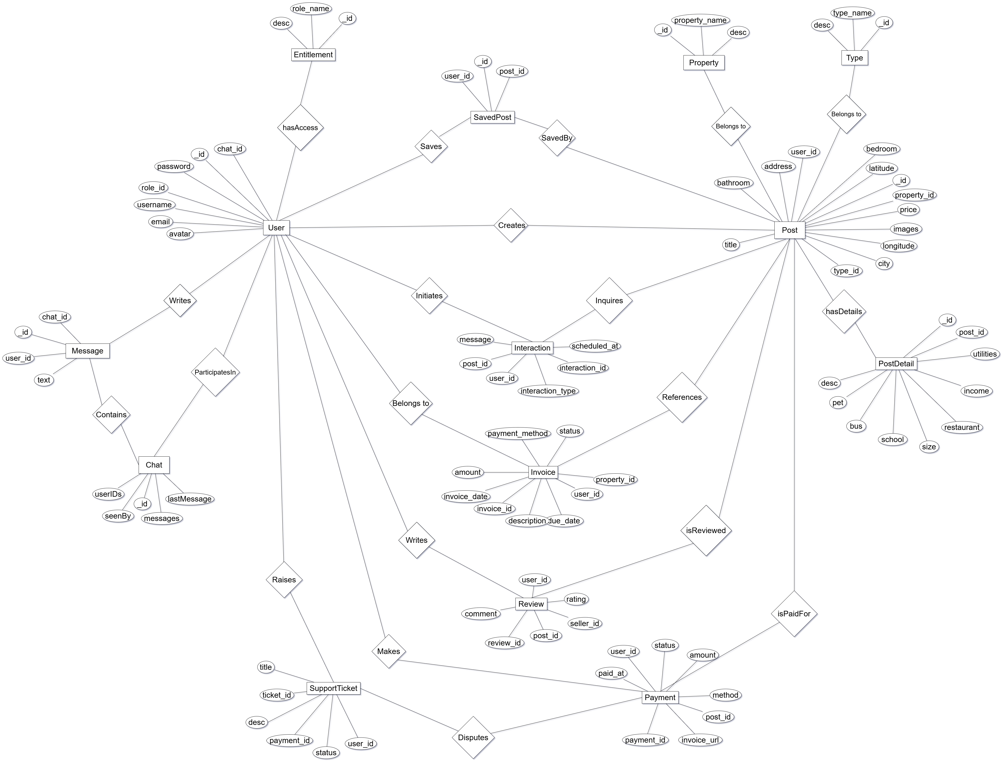
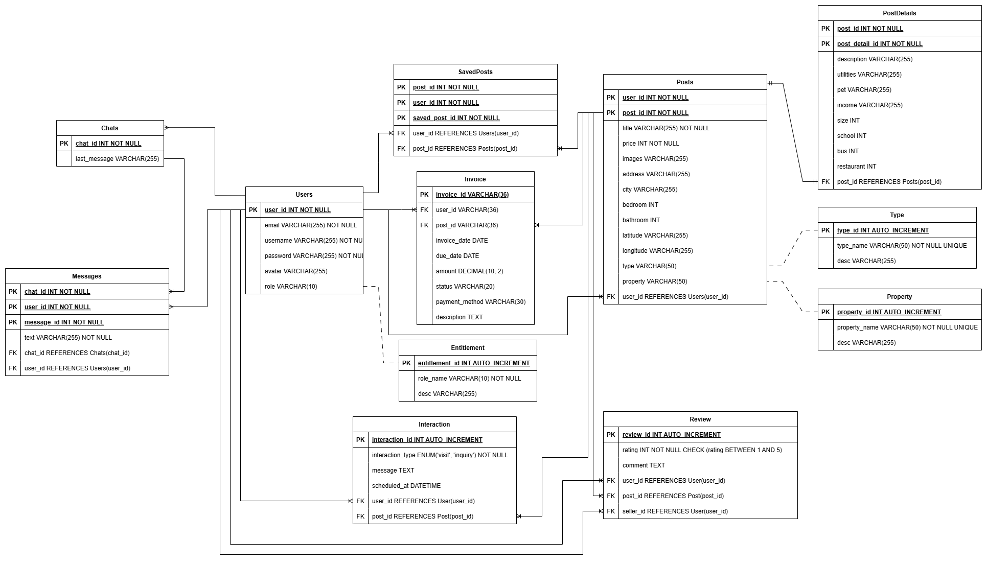
ER DIAGRAMS - (NITANT PARESHBHAI BHAGAT)
CONCEPTUAL VIEW
LOGICAL VIEW

Slide 10
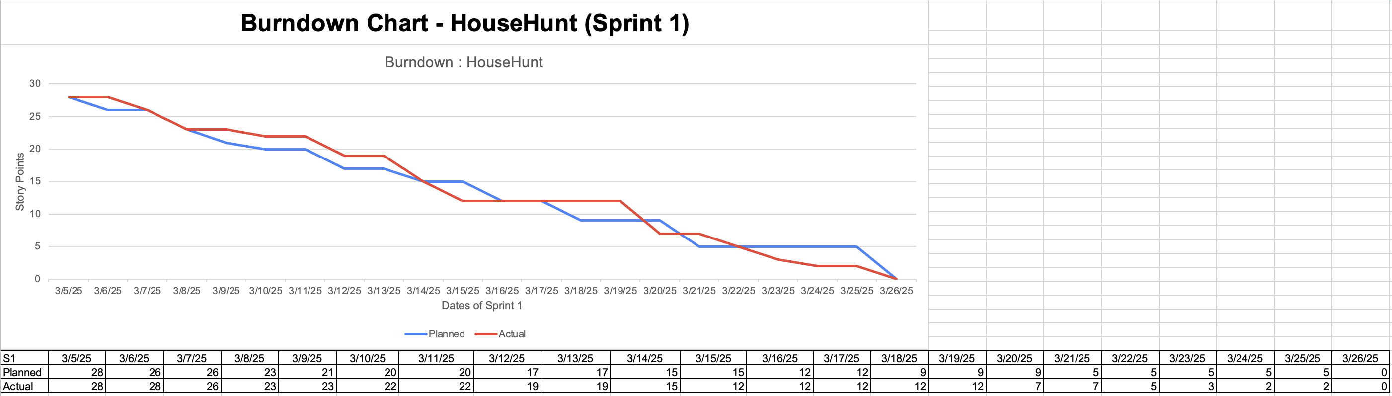
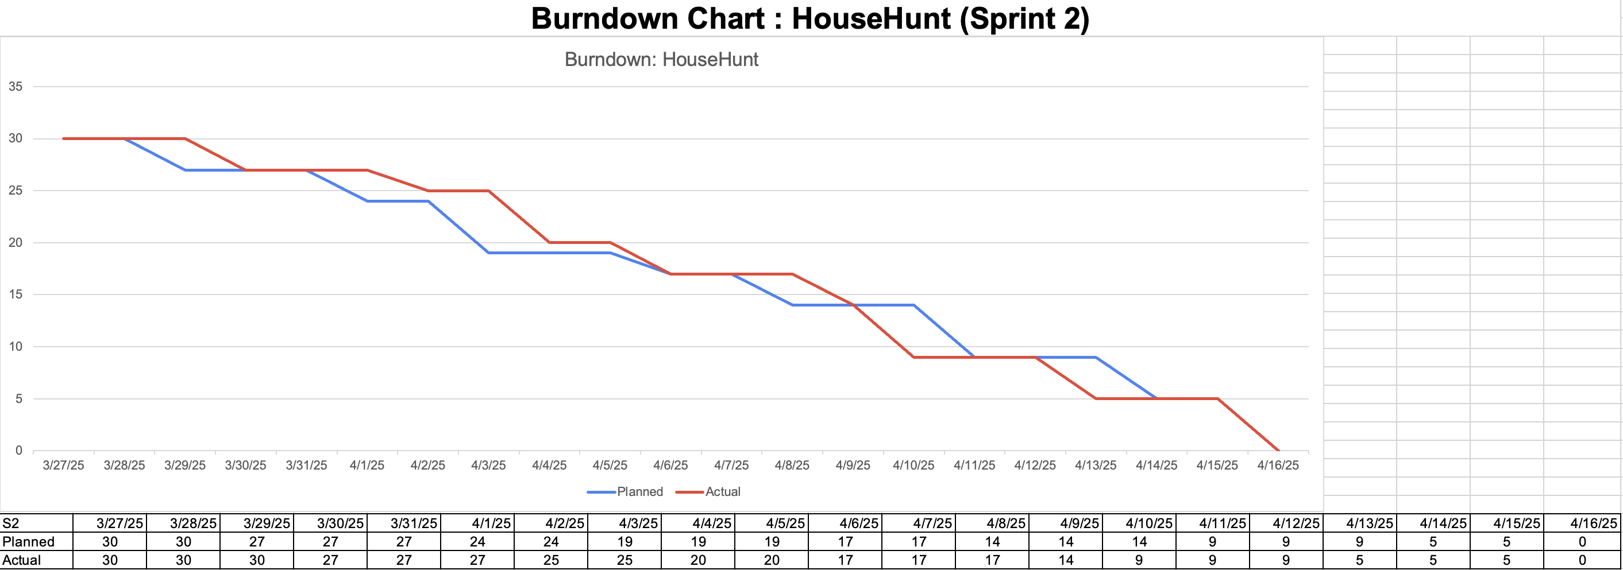
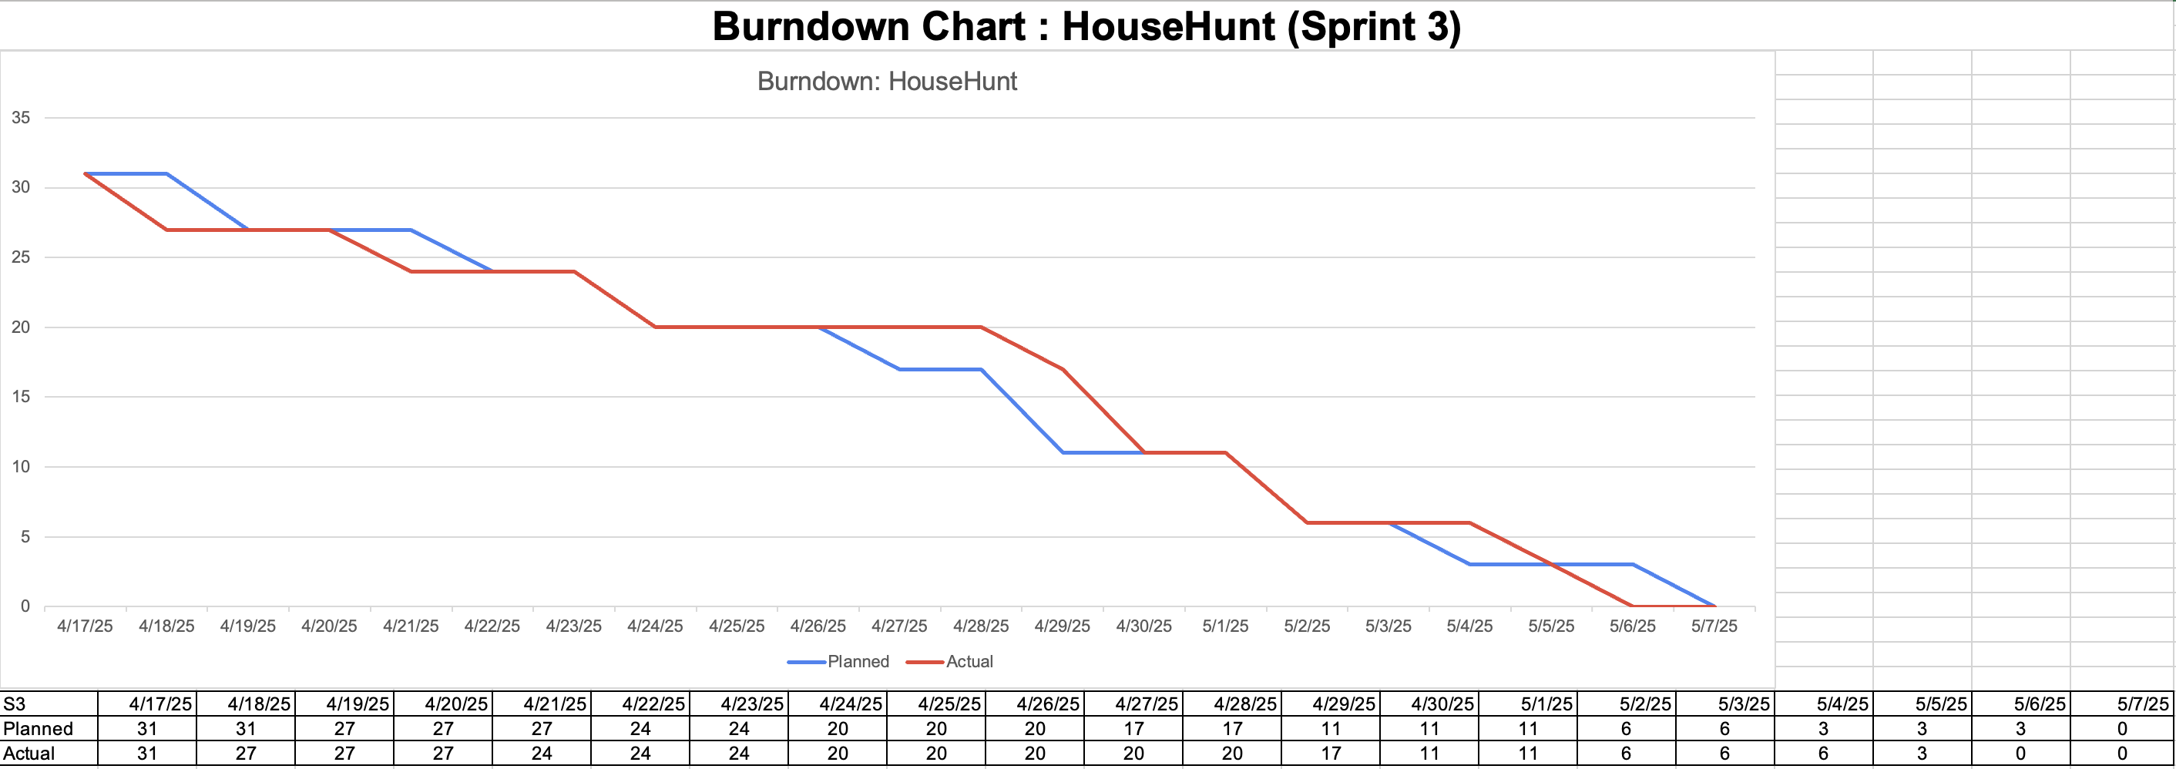
BURNDOWN CHARTS - (JENISHA BHAVESHBHAI GAJERA)

Slide 11
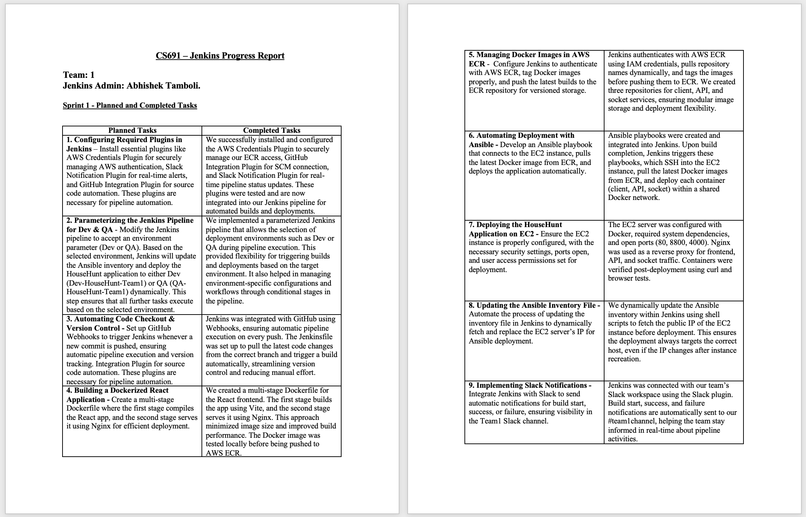
JENKINS PROGRESS REPORT - (ABHISHEK SUNIL TAMBOLI)

Slide 12
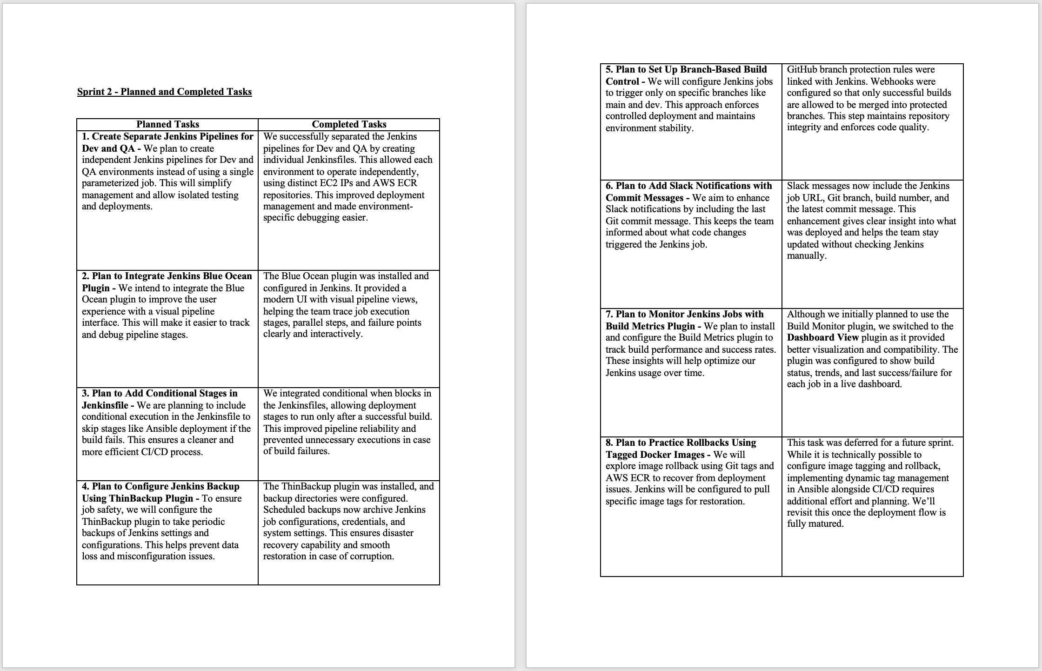

Slide 13
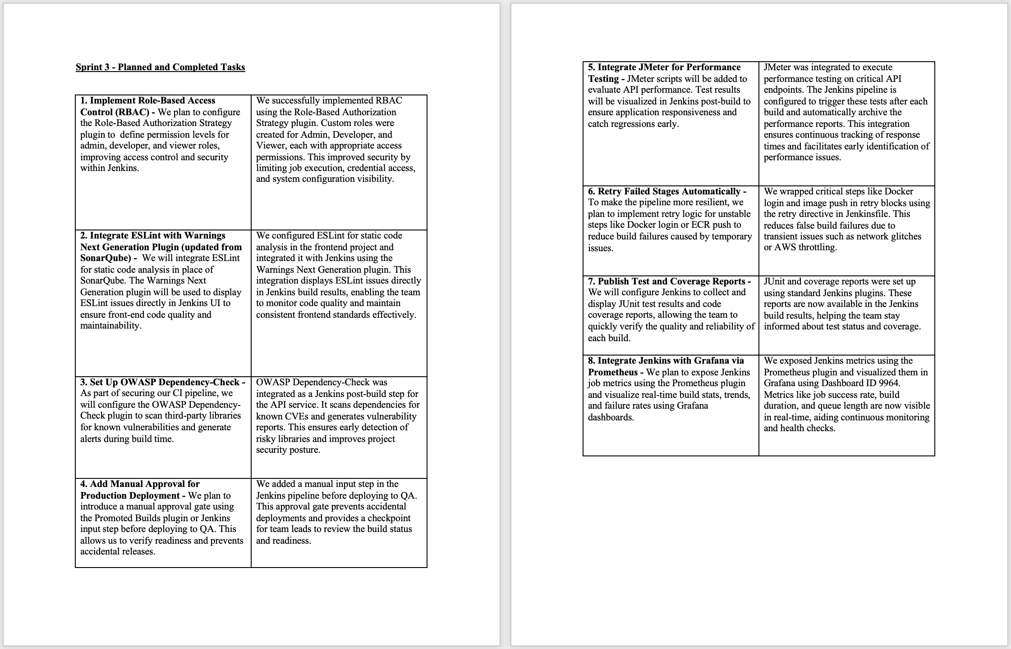

Slide 14
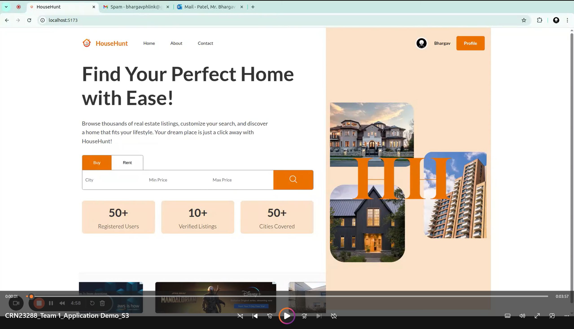
APPLICATION DEMO - (BHARGAV PATEL)

Slide 15
Thank You!

